Slide 1
Databases– Part 2
Lesson 1 & 2
http://www.yahmad.co.uk/

Slide 2
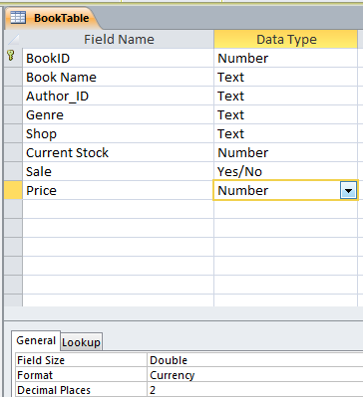
Starter 1 – What are Data Types?
Text
Currency
Double
Date/Time
Boolean
OLE Object
Number (Integer)
http://www.yahmad.co.uk/

Slide 3
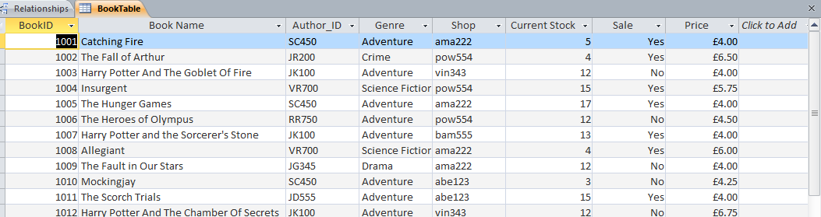
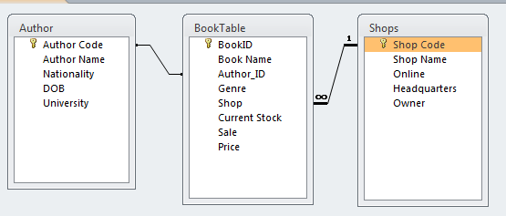
Starter 2 – Types of Databases?
A database is information organized in such a way that a computer program can quickly select pieces of data.
Flat File Database
A 'flat-file' database is one that only contains a single table of data
Relationship Database
A 'relational' database is one that contains two or more tables of data, connected by key fields.
http://www.yahmad.co.uk/

Slide 4
Starter 3 – Relationship Databases?
One to Many Relationships
Teacher
(Primary Key)
Students
(Foreign Key)
The 'One' side is usually the primary key
The 'Many' side is usually the foreign key
A relational database has more than one table and the tables are linked using key fields.
Advantages
Teacher details only need to be entered once into the database.
Mistakes are less likely to happen when entering data if it already exists.
Avoids duplicating data.
Data can be accessed using key fields (Primary and Foreign Keys).
Queries and reports can be created using data (fields) from a number of tables which have a relationship.
http://www.yahmad.co.uk/

Slide 5
Lesson Overview
Objectives
Understand the different types of Databases.
Understand how to import CSV files into a Database.
Understand how to establish relationships between key fields.
Understand how to add and update records.
Outcomes |  | Time
Task 1 | Import the CSV File
Task 2 | Create One to Many Relationship
Task 3 | Add 10 new Records
Task 4 | Update Records
http://www.yahmad.co.uk/

Slide 6
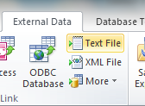
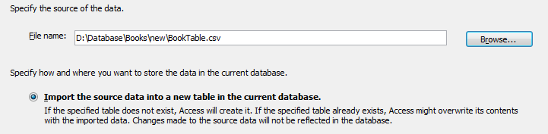
Task 1 – Import CSV
Microsoft Access:
A comma-separated values (CSV) file stores tabular data (numbers and text) in plain-text form. You have to import the BookTable, Shops and Author.
Click on External Data >> Text File Browse for the CSV File and then click OK to proceed. Check the date format (DMY) and apply appropriate field types. Select appropriate primary key for each table.
1
2
Refer to the Video Tutorial
http://www.yahmad.co.uk/

Slide 7
Task 1 – Import CSV (Data Types)
Shops
Field | Data
Shop Code | Text
Shop Name | Text
Online | Boolean Y/N
Headquarters | Text
Owner | Text
Book Table
Field | Data
BookID | Number
Book Name | Text
Author_ID | Text
Genre | Text
Shop | Text
Current Stock | Number
Sale | Boolean Y/N
Sold | Number
Price | Currency
Authors
Field | Data
Author Code | Text
Author Name | Text
Nationality | Text
DOB | Date/Time
University | Text
Import as Double then change to currency (2dp) in design View.
Key Fields (Primary)
Key Fields (Foreign)
http://www.yahmad.co.uk/

Slide 8
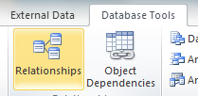
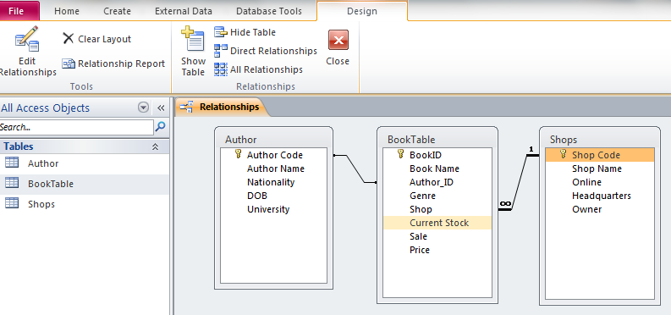
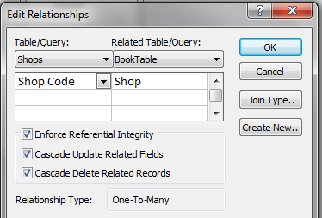
Task 2 - Relationships
Creating one to many relationships
Click on Database tools and then relationships. Add all tables Establish Relationships using the key fields Author Code (P) >> Author_ID (F) Shop Code (P) >> Shop (F)
Click all boxes.
http://www.yahmad.co.uk/

Slide 9
Task 3 – Adding Records
1. Add new author record to the Author Table. 2. Add 10 news records to the book Table.
Author Code | Author Name | Nationality | DOB | University
RL222 | Robert Lawrence Stine | American | 08/10/1943 | Ohio State University
Book Name | Author_ID | Genre | Shop | Current Stock | Sale | Sold | Price
Red Rain | RL222 | Horror | abe123 | 5 | Yes | 4 | £5.50
Monster Blood | RL222 | Horror | pow554 | 12 | No | 5 | £4.50
The Haunted Mask | RL222 | Horror | vin343 | 17 | Yes | 3 | £6.50
The Werewolf of Fever Swamp | RL222 | Horror | abe123 | 3 | Yes | 4 | £4.50
The Secret Bedroom | RL222 | Horror | pow554 | 33 | No | 3 | £4.70
Let's Get Invisible | RL222 | Horror | vin343 | 21 | No | 3 | £3.50
My Hairiest Adventure | RL222 | Horror | abe123 | 16 | Yes | 5 | £6.50
Ghost Beach | RL222 | Horror | bam555 | 19 | Yes | 1 | £4.50
Creep from the Deep | RL222 | Horror | pow554 | 33 | No | 4 | £5.50
The Curse Of The Mummy's Tomb | RL222 | Horror | vin343 | 23 | No | 2 | £4.50
http://www.yahmad.co.uk/

Slide 10
Task 4 – Updating Records
Update the following Stock Levels: The Hunger Games – 11 Harry Potter And The Chamber Of Secrets – 9 The Rule of Thoughts – 5 Year of the Jungle - 17 Harry Potter and the Deathly Hallows – 7 The Lost Hero – 3 Harry Potter and the Half-Blood Prince - 13 The Titan's Curse – 15 The Fall of Arthur - 13 Update the following Prices: The Heroes of Olympus - £5.75 The Fault in Our Stars - £3.75 The Rule of Thoughts - £4.75 The Eye of Minds - £5.75
Extension: Add 10 additional books from the authors listed in the authors table. You can make up the information for some of the records (price, stock level etc).
http://www.yahmad.co.uk/

Slide 11
Plenary – Refer to the Lesson Objectives
Objectives
Understand the different types of Databases.
Understand how to import CSV files into a Database.
Understand how to establish relationships between key fields.
Understand how to add and update records.
Plenary Task (Q&A)
Peer Assess each others work and suggest possible improvements. Discuss the levels pupils have achieved for this task.
http://www.yahmad.co.uk/

